Slide 1
Autism Sprectrum Disorder

Slide 2
GROUP MEMBERS
-
Brijit Adak
21052410
-
Saurabh Sushant
21051335
-
Diptendra Maity
21051562
ADD YOUR TEXT
Brijit Adak
-
ADD YOUR TEXT
Arijit Mistry
21051721

Slide 3
01
Introduction
Machine learning
and Deep Learning
algorithms used
in ASD
02
Description
05
CONTENTS
03
Treatment
therapies
Comparison of
results
06
04
Technology used
in Autism detection

Slide 4
07
Dataset used
in experiment
11
Conclusion
Questions in
dataset
08
CONTENTS
12
References
Chart of accurancy,
precision,recall and
f1-score
09
10
Future Plan

Slide 5
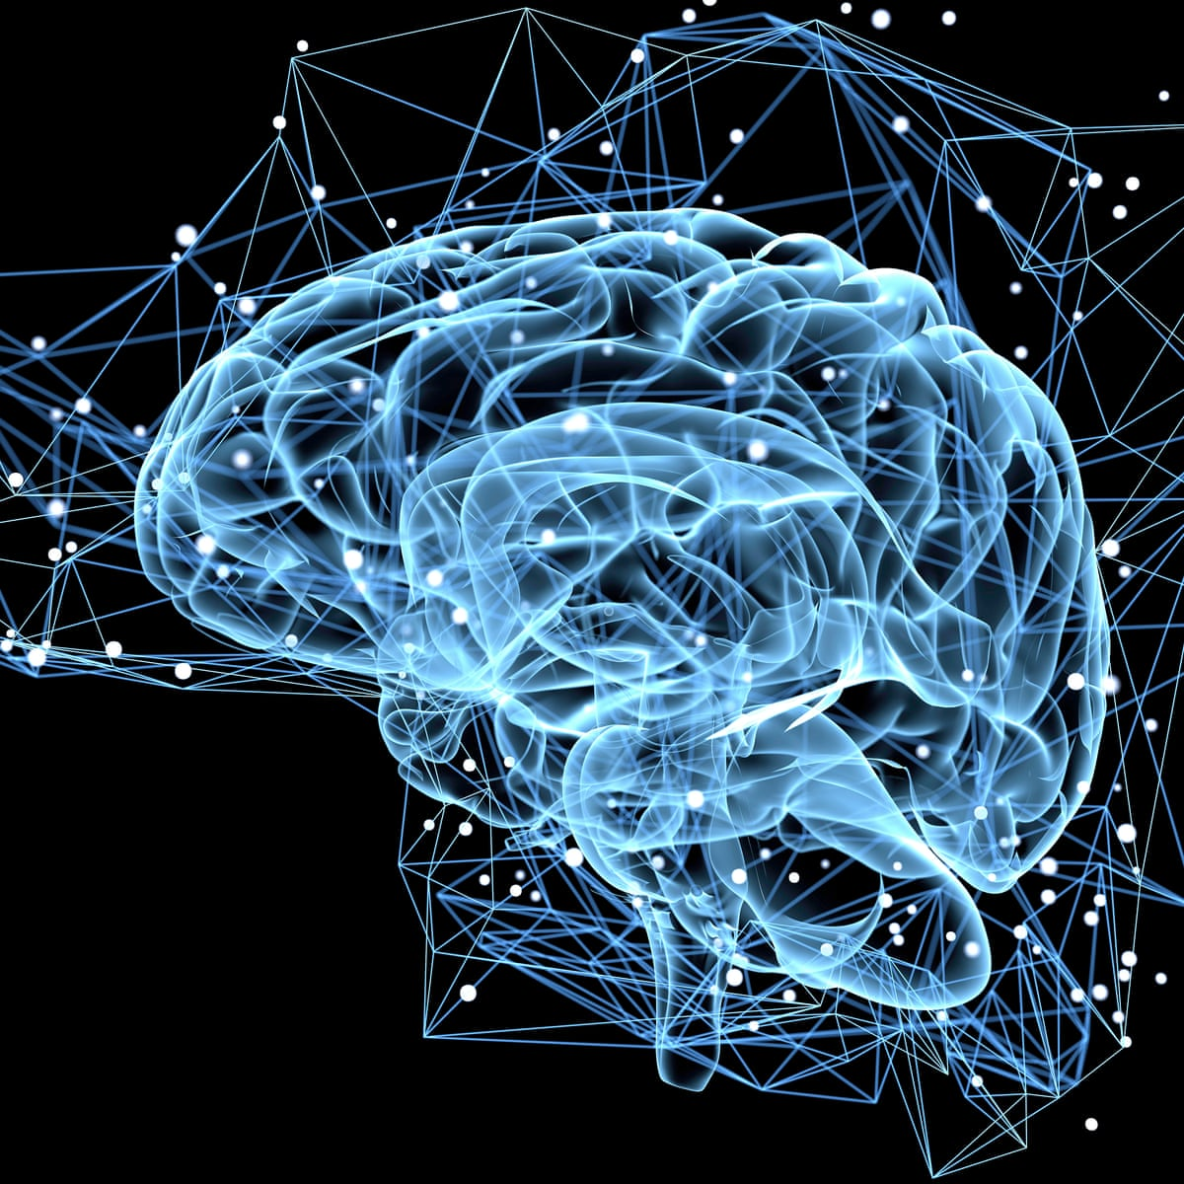
INTRODUCTION
This presentation provides a comprehensive overview of Autism Spectrum Disorder (ASD), covering its characteristic, diagnosis, and treatment options . Gain a deeper understanding of this complex neurodevelopmental condition.

Slide 6

What is ASD?
Autism, described first by Kanner in 1943, is a developmental disorder commencing in early childhood.
complex neurodevelopmental condition.
Boys are 4 times more likely than girls to be affected.
challenges with social communication and repetitive behaviors.
spectrum disorder, meaning its impact varies widely from person to person.

Slide 7
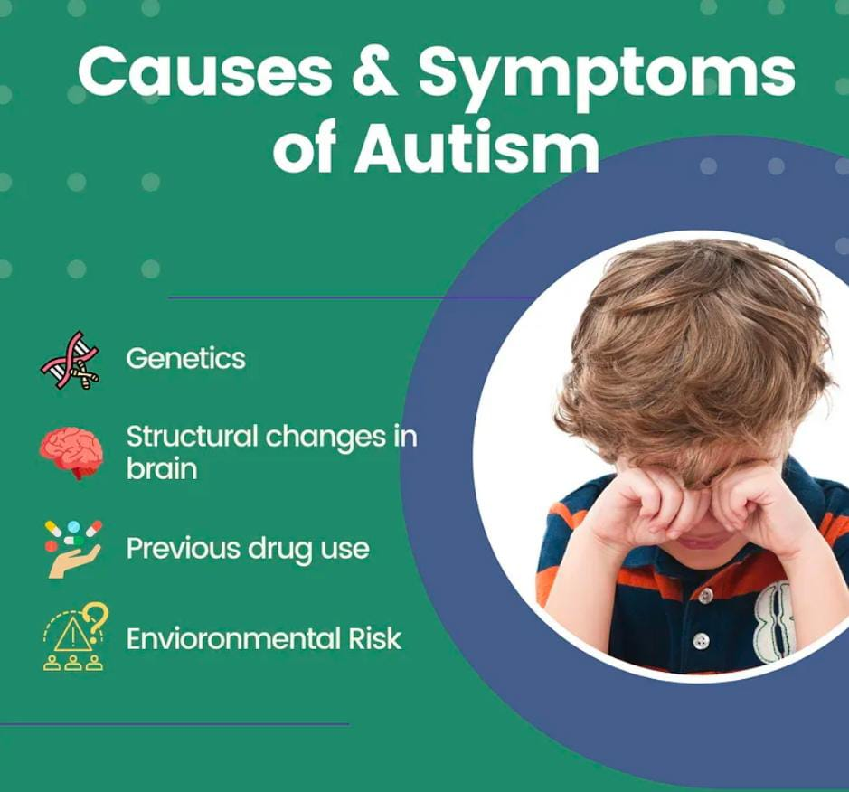
WHAT IS THE CAUSE OF AUTISM?
The cause of autism is unknown and no one particular anatomical, biochemical or genetic disorder has been found in those who suffer from it. The problem appears to lie in that part of the brain responsible for the development of language.

Slide 8
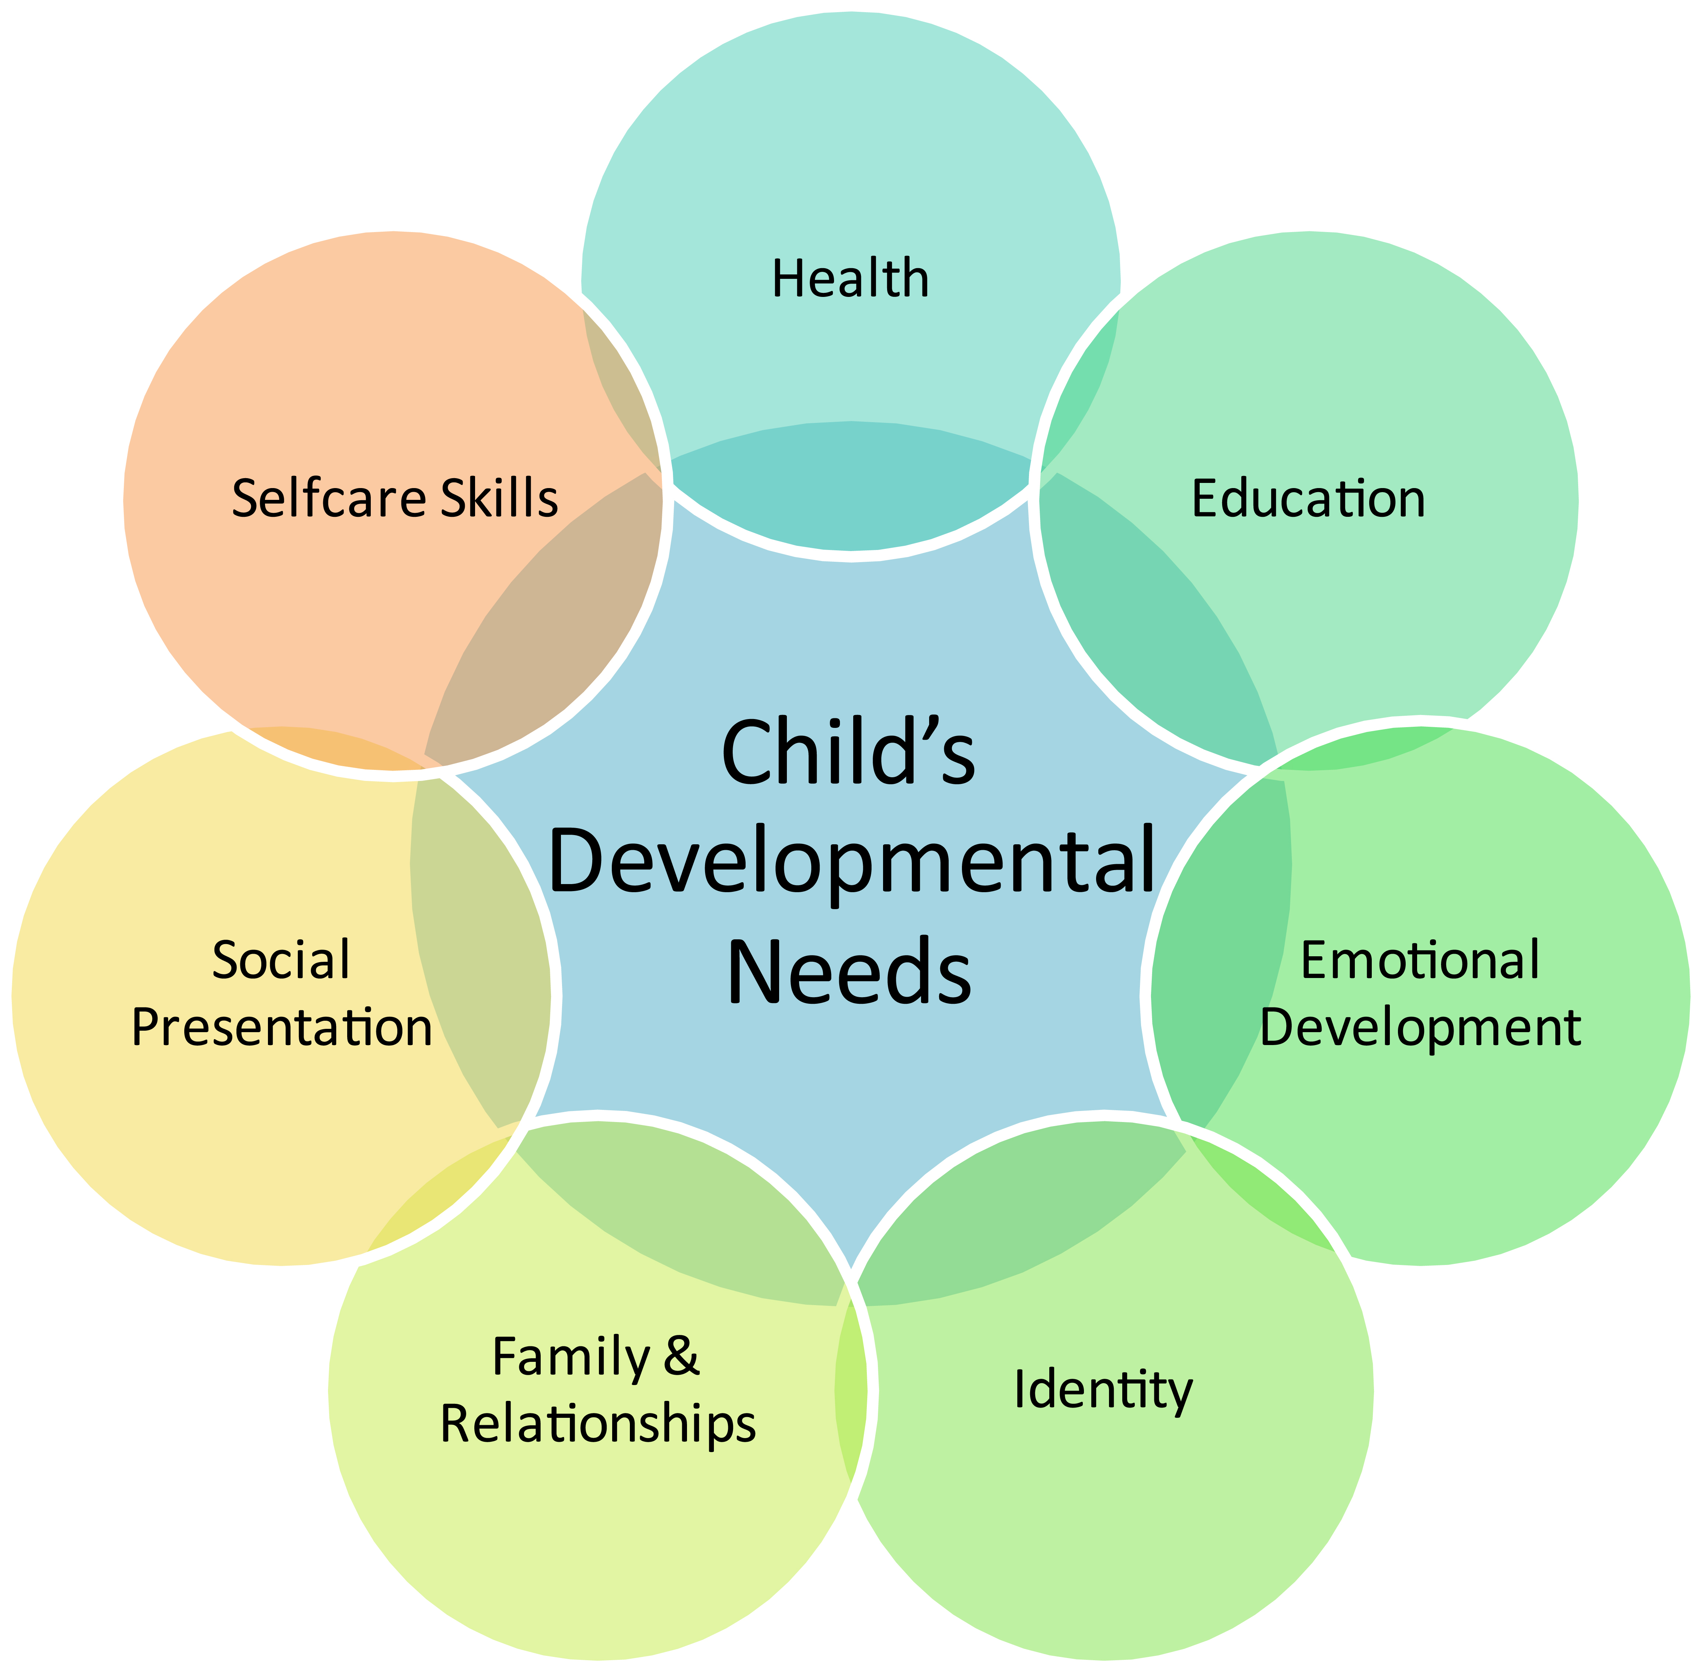
Diagrams

Slide 9
Signs of Autism
Inappropriate playing with toys
Inability to relate to others
Hyperactivity or passiveness
Inappropriate laughing or crying
Oversensitive or undersensitive to sounds
Strange attachment to objects
Poor Speach or lack of speach
Difficulty dealing with challenges to routine
Lack of awareness to danger

Slide 10
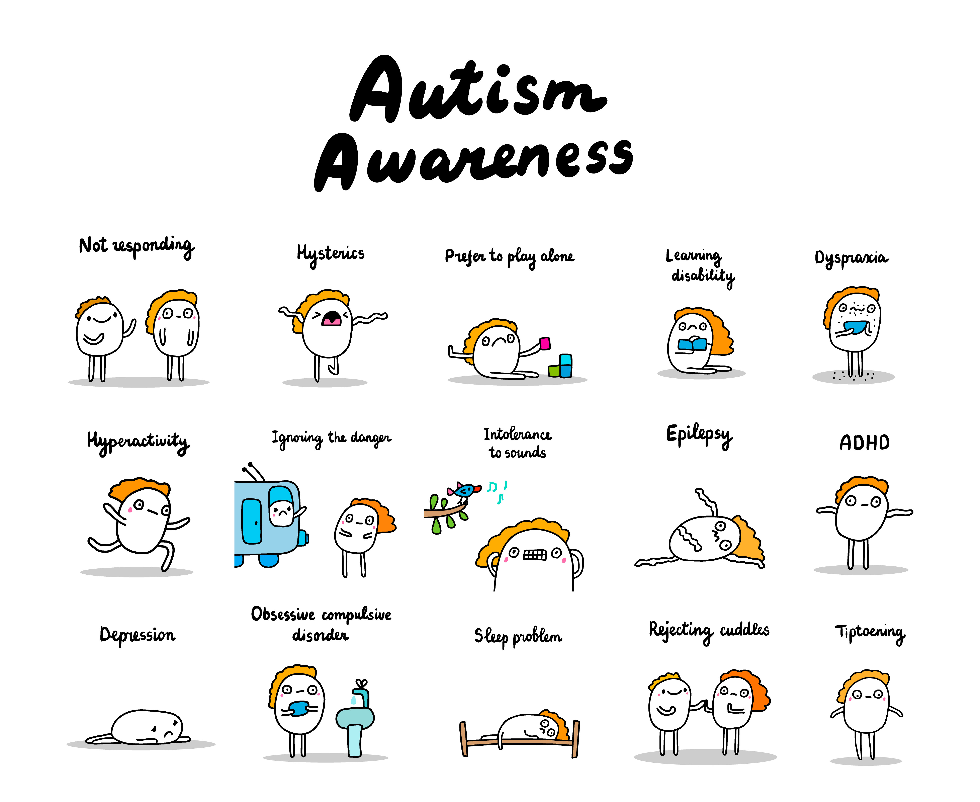
Signs of Autism
Not responding
Hysterics
Prefer to Play alone
Learning Disability
Dyspraxia
ADHD (attention deficit hyperactivity disorder)
Depression
Obsessive complusive disorder
Sleep problem
Rejecting cuddles
Tiptoering

Slide 11
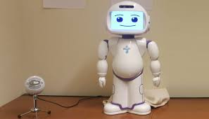

Treatment therapies for autism
Therapy sessions are meetings with patients with a goal to improve some aspects of their life.Initiating it early may help to improve skills and resolve their symptoms. Some of them are mentioned below:
Socially Assistive Robotics (SAR):
It refers to the robotics that focuses on developing robots designed to interact
with humans in emotionally intelligent manner.
They teach and demonstrate socially beneficial behaviors. This tool assists children in expressing themselves in a better way.
Nutrition therapy:
It is typically conducted by registered dietitians.Getting enough vitamins, minerals, and healthy fats from food is really important. A good diet can help manage some of the symptoms of autism and keep them under control.

Slide 12
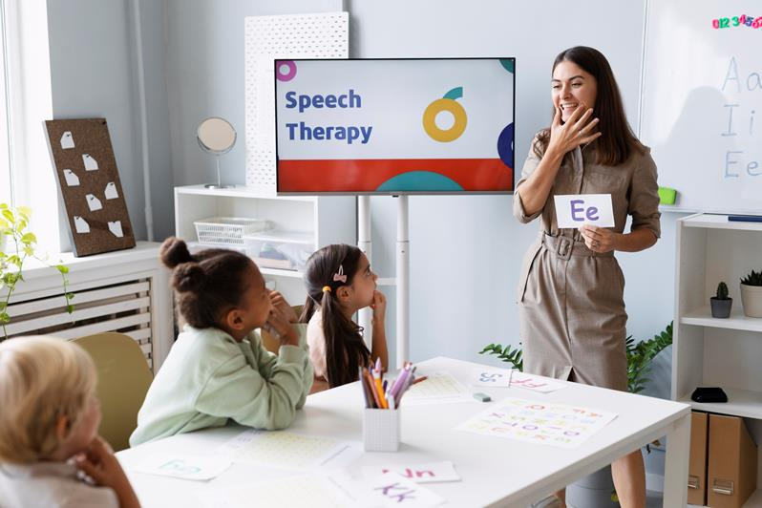
Treatment therapies for autism
Speech Therapy:
It is helpful in resolving communication and speech issues.
Children can make use of sign language or images to communicate.
It enhances the clarity in sound production.
Occupational Therapy:
The primary goal of occupational therapy is to enable individuals
to participate in activities that are meaningful to them.It helps them get better at everyday tasks. In therapy, they focus on what each person needs and what they want to achieve.

Slide 13
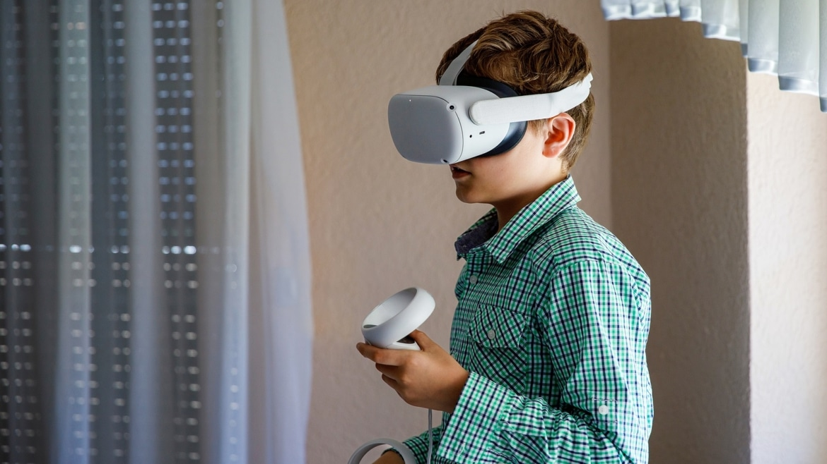
Technology used in Autism detection
Technology is helpful for people with autism. It helps them learn and communicate better. For example,
if they have very little focus duration,they can use pictures and sounds to keep them focused.
Some of them are as follows:
Gaming:
That is Learning vocabulary using games
Virtual Reality:
Real world is presented to autistic children with help of Virtual Reality.
Augmented Reality:
Facial expressions can be used to detect the symptoms.
Social Robots:
Social robot are used by therapists for communication,thus Helping
children with less involvement.

Slide 14
ML Algorithms Details
Following Machine Learning Algorithms were tried:
Random Forest: Classification
Though Decision trees works very well for classification, Random forest is used to take care of overfitting.
Random forest is much more powerful than Decision trees when trees are diverse.
Decision Trees : Classification
It’s a non-parametric supervised learning algorithm for Classification and regression.
It has a problem of overfitting.
Naïve Bayes : Supervised Classification
It is based on Bayes Theorem, and it’s used for solved classification problems.
It’s mainly used for text classification.

Slide 15
ML Algorithms Details – Conti-
Following Machine Learning Algorithms were tried:
Logistic Regression: Binary Classification
It is used to predict the categorial dependent variable.
It answers mostly in the format yes or no.
Support Vector Machine: Supervised Classification
It creates best line or decision boundary that can best segregate n dimensions spaces into classes to accommodate new data points.
KNN
It memorizes the training data and makes predictions based on the closest training examples (neighbors) when queried.

Slide 16
DL Algorithms Details
Following Deep Learning Algorithms were tried:
CNN
Primarily used for processing and recognizing patterns in images, videos, and other grid-like data.
Convolutional Layer - Extracts the features
Pooling Layer - Down Samples
Flattening - Converting multidimentions to 1 dimention
Fully Connection - Connects the nurons
Compile CNN - adding optimizer, loss functions
Artificial Neural Network :
Deep Learning algo.
It uses Neural network.
DNN :
Deep Learning algo.
consists of multiple hidden layers between the input and output layers

Slide 17
Following Deep Learning Algorithms were tried:
LSTM
Deep Learning algo.
LSTMs use three main gates—input, forget, and output gates—to control the flow of information.
highly effective for sequential data tasks, such as time series forecasting, natural language processing, and speech recognition, where patterns unfold over time.
LSTMs are designed to learn long-term dependencies in data, which makes them ideal for applications that require memory of previous information, like predicting words in a sentence.
XGB
One of the best boosting algo. and faubourite to all data scientists.
Speed and Performance wise more optimized.
Here each new tree corrects the errors of the previous ones, and the model improves iteratively.
Speed -> Paralalization, Cache optimization, Out of memory computation.
Performance -> Regularization, Auto Pruning, Missing vlaue treatment.
Gemini
LLM algo.
In this model this is trained on Random forest and returns data as provided.

Slide 18
Integration of Gemini
Integrated Gemini to make our project user interactive and that can predict and show real time data.
What is Gemini
An AI model by google.Its competitors are Meta LlamMa and GPT-4.Google plans to integrate this model to its products.
It can comprehend audio,video,image,text and code.
it offers free API
What it does
Made an application which connects users to Random Forest model so using it in real time on unseen data.
Users can Input their all 19 features values and get a prediction done by Random Forest in POSTMAN platform.
How its made
A pkl file was generated which stores the trained model.
Made reference of this pkl file in application codebase and also added the API key.
It makes a mediator that acts as a bridge between the users and the trained model

Slide 19
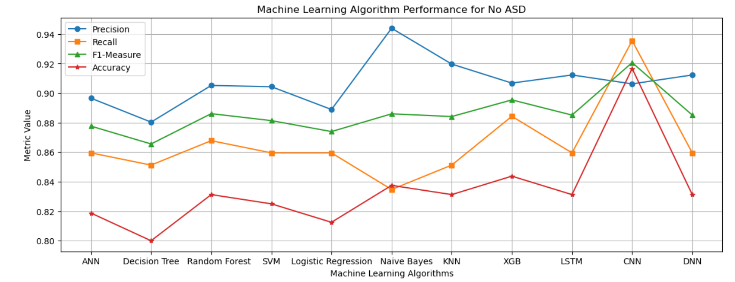
Comparison of results
Ranking of the models based on the results of below parameters:
Recall
It can be concluded that better performance is given by Naive Bayes, XGB and CNN.

Slide 20
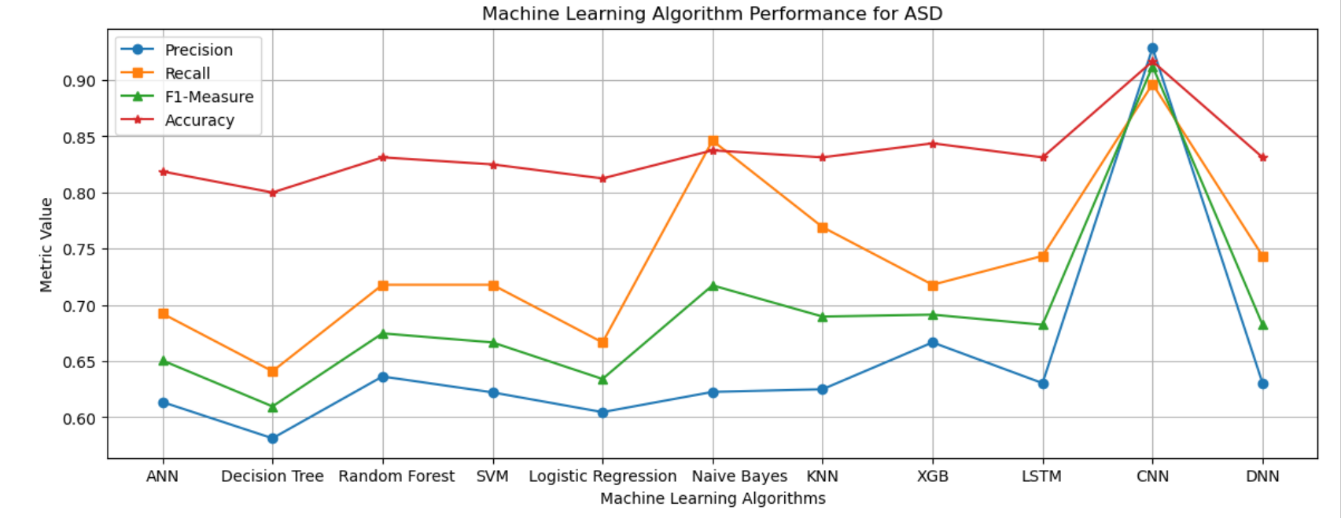
Comparison of results
Ranking of the models based on the results of below parameters:
Recall
It can be concluded that better performance is given by Naive Bayes, XGB and CNN.

Slide 21
System Architecture
Applying ML Algorithms
Data Reprocessing
(Normalization & Eliminating missing values)
Loading of Preprocessed Data
Evaluation of ASD and no ASD classes
Autism Raw Dataset
Applying DL Algorithms

Slide 22
Datasets used in the Experiment
UCI Machine Learning Repository made available by Fadi Fayez Thabtah.
Another Deep Lerning Repository made available in Kaggle.
ASD screening child dataset -> 292 (141 ASD:151 non-ASD) records.
Adolescent Dataset -> 104 (63 ASD:41 non-ASD) records.
Adult Dataset -> 704(189 ASD:515 non-ASD) records.
There are 21 properties in which 10 questions (AQ1-AQ10) are about behavioural information and 10 demographic attributes with one class label as either yes or no.
Here we used A1_Score to A10_Score, age, gender, ethnicity, jaundice, austim, contry_of_res, used_app_before, result, age_desc, Class/ASD for training our model.

Slide 23
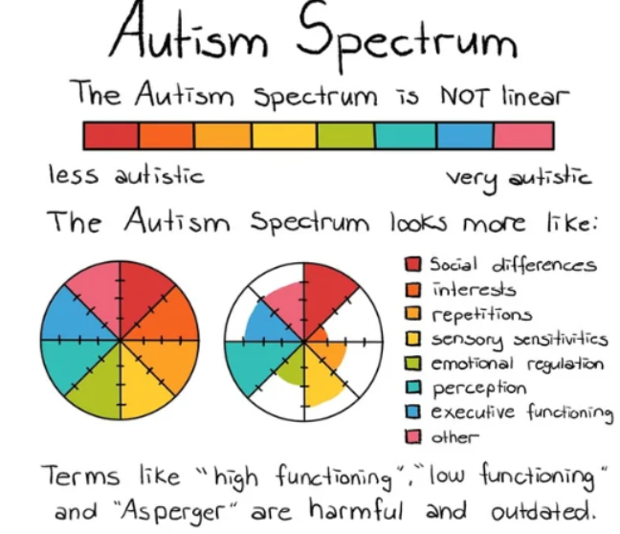
Questions in Dataset
Able to hear sound that others can't hear.
Targets on large picture than small details.
Pursue the discussions of people in a
community group.
Can effectively switch between available actions.
No idea about how to chitchat with peers.
Fine for day-today small chats.
Finding hard to understand emotions while
reading a book.
Fond of playing role plays as part of
(pre-school) education.
Recognize their experience by observing
facial expressions
Hard to create new friends
Background('White-European', 'South Asian',

Slide 24
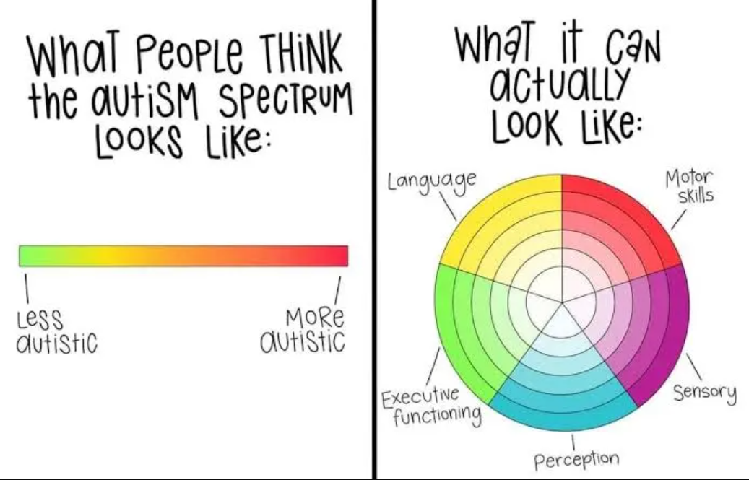
Questions in Dataset
'Asian', 'Middle Eastern ', 'Pasifika',
'Hispanic', 'Turkish','Latino', 'Black',
'Others', 'Unknown')
Born with jaundice (yes, no)
Family member with PDD (yes, no)
Country
Familiar with the screening app (yes, no)
Score
Age_desc
Who has attempted the test
Class/ASD

Slide 25
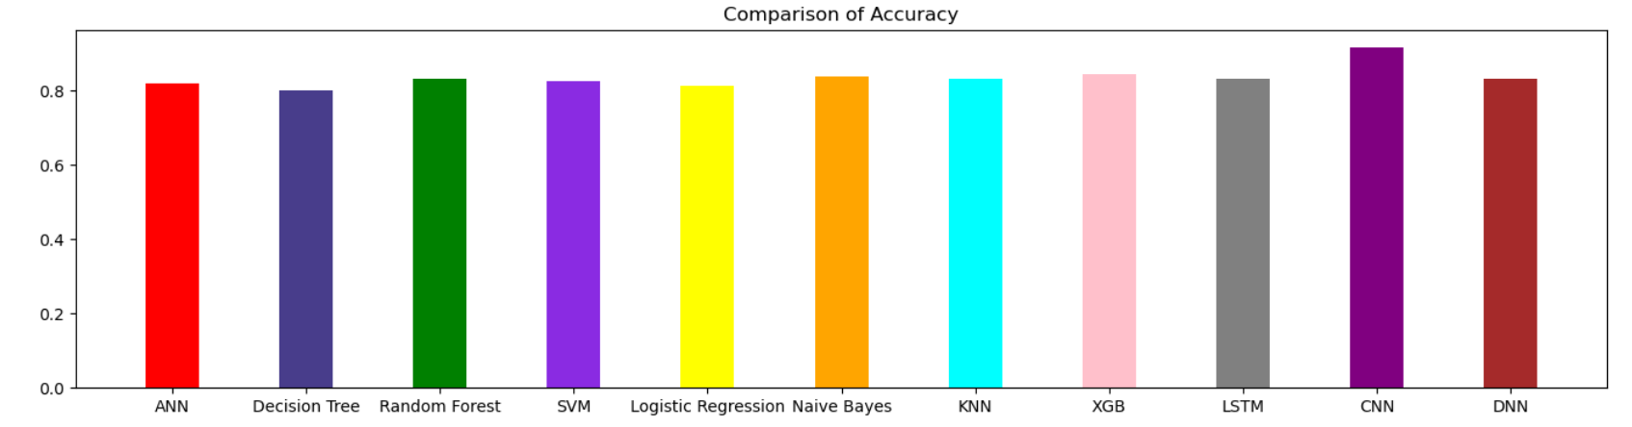
Model Evaluation Chart
1. Accuracy=(TP+TN)/(TP+TN+FP+FN)

Slide 26
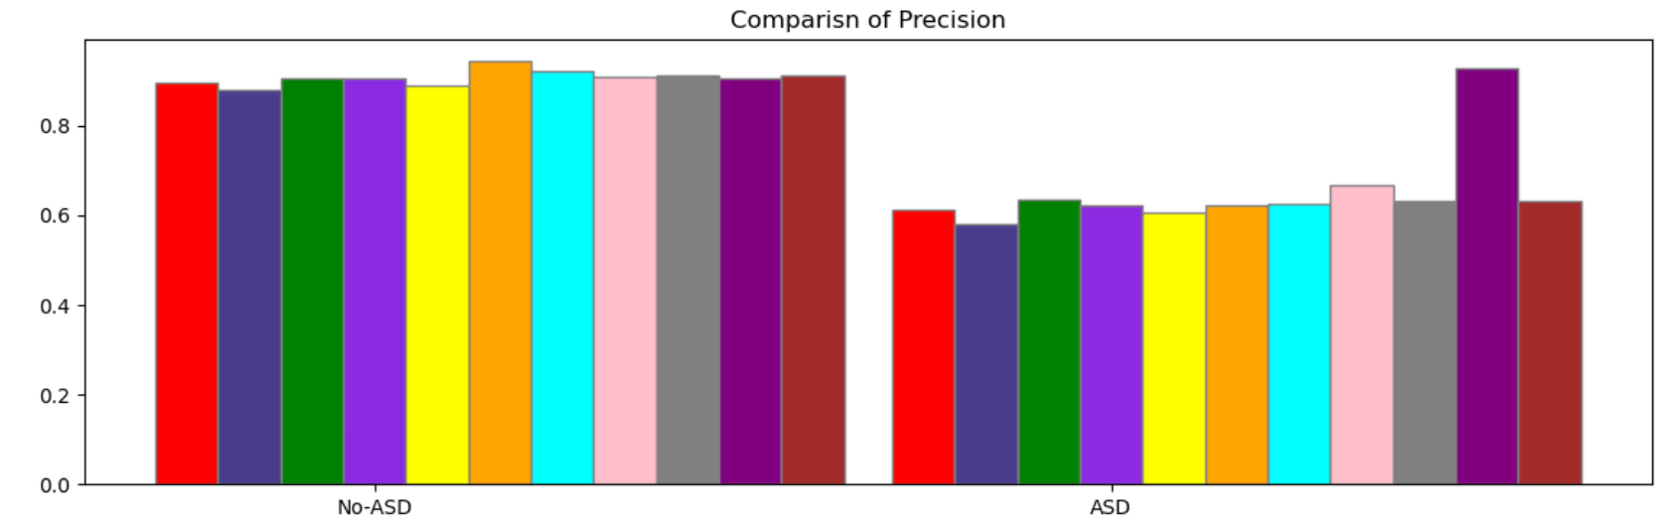
Model Evaluation Chart
2. Precision= TP/(TP+FP)

Slide 27
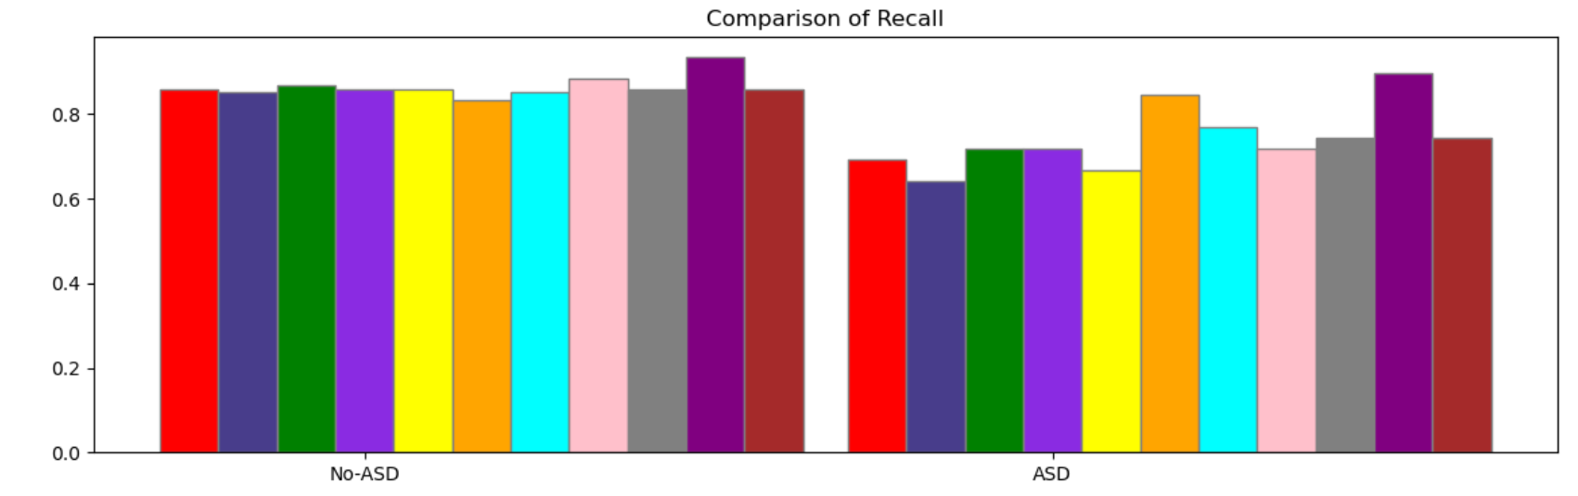
Model Evaluation Chart
3. Recall= TP/(TP+FN)

Slide 28
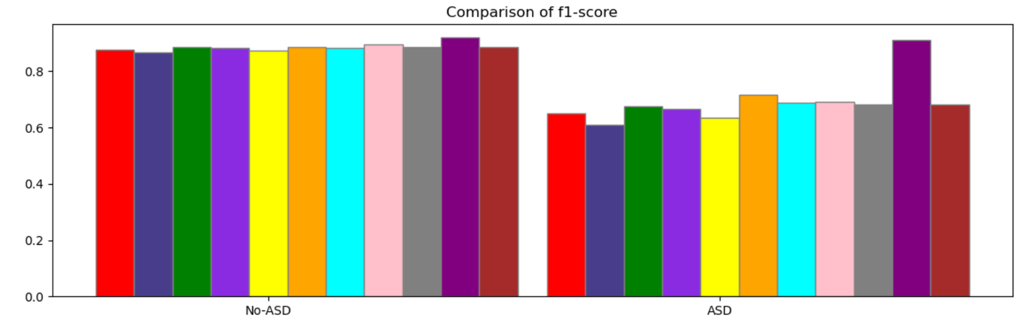
Model Evaluation Chart
4. F1-Score =2(Recall*Precision)/(Recall+Precision)

Slide 29

Future Plans
At future our goal is to collect more no of patient data through any authenticated source.
Implement other models to get the best possible outcome.
Reevaluate our input attributes and updating them if after that better result comes

Slide 30
Conclusion
In conclusion, autism spectrum disorder (ASD) is a complex neurodevelopmental condition that affects individuals in diverse ways. Through this presentation, we've explored the key characteristics, diagnostic criteria, prevalence, and potential causes of autism. It's crucial to recognize that each person with autism is unique, with their own strengths and challenges.
While there is still much to learn about autism, increased awareness, acceptance, and support are essential for improving the lives of individuals on the spectrum. Early intervention and personalized therapies can significantly enhance outcomes and help individuals with autism reach their full potential.
As we continue to advance our understanding of autism, let us strive for a society that embraces neurodiversity, promotes inclusivity, and provides equal opportunities for individuals of all abilities. Together, we can create a more compassionate and supportive world for everyone, including those with autism.

Slide 31
References
American Psychiatric Association. (2013). Diagnostic and Statistical Manual of Mental Disorders (5th ed.). Arlington, VA: American Psychiatric Publishing.
Baio, J., Wiggins, L., Christensen, D. L., et al. (2018). Prevalence of Autism Spectrum Disorder Among Children Aged 8 Years — Autism and Developmental Disabilities Monitoring Network, 11 Sites, United States, 2014. MMWR. Surveillance Summaries, 67(6), 1–23.
Happé, F., & Ronald, A. (2008). The ‘fractionable autism triad’: a review of evidence from behavioural, genetic, cognitive and neural research. Neuropsychology Review, 18(4), 287–304.
Lai, M. C., Lombardo, M. V., & Baron-Cohen, S. (2014). Autism. The Lancet, 383(9920), 896–910.
National Institute of Mental Health. (2019). Autism Spectrum Disorder. Retrieved from https://www.nimh.nih.gov/health/topics/autism-spectrum-disorders-asd/index.shtml
Volkmar, F. R., & McPartland, J. C. (2014). From Kanner to DSM-5: Autism as an Evolving Diagnostic Concept. Annual Review of Clinical Psychology, 10, 193–212.
World Health Organization. (2018). Autism Spectrum Disorders. Retrieved from https://www.who.int/news-room/fact-sheets/detail/autism-spectrum-disorders

Slide 32
THANK YOU

